Slide 1

System Development NQF LEVEL - 5

Slide 2
Unit standards to be covered
 | ID | Title | Credit | Pages
Fundamentals | 114059 | Demonstrate an understanding of estimating a unit of work and the implications of late delivery | 5 | 3 - 17
Fundamentals | 114076 | Use computer technology to research a computer topic | 3 | 18 - 28
Fundamentals | 115431 | Analyze feedback contexts and apply constructive feedback techniques | 3 | 29 - 37

Slide 3

114059 : Demonstrate an understanding of estimating a unit of work and the implications of late delivery

Slide 4
PURPOSE OF THE UNIT STANDARD
This unit standard is intended to provide a conceptual knowledge of the areas covered.
For those working in or entering the workplace in the area of systems development.
Demonstrate the ability to interpret given cost/benefit analysis documentation
Prepare a time estimate for an element of work
Prepare a cost estimate for an element of work
Demonstrate an understanding of the affect of late delivery of an element of work
The performance of all elements is to a standard that allows for further learning in this area.

Slide 5
LEARNING ASSUMED TO BE IN PLACE AND RECOGNITION OF PRIOR LEARNING
The credit value of this unit is based on a person having the prior knowledge and skills to:
Demonstrate an understanding of fundamental mathematics (at least NQF level 3)
Demonstrate PC competency skills (End-User Computing unit Standards, at least up to NQF level 3.)

Slide 6
Specific outcome: 1
Demonstrate the ability to interpret given cost/benefit analysis documentation.
What is cost benefit analysis?
Cost benefit analysis (CBA) is a technique for assessing the monetary social costs and benefits of a capital investment project over a given time period.
Appraisal of a project
Incorporates externalities into the
equation
Time matters
The principles of cost-benefit analysis (CBA) are simple

Slide 7
Cost Benefit Analysis Components
General description of the project
This is an explanation on the environment where each analysis is done such as the objectives, the assumptions , the project , decision life etc.
List of alternative scenarios
To decide the best option in the CBA we consider the costs and the benefits for each of these options.
Identify Benefits and Costs
The application lists the exact benefits and costs met in each of the alternative scenarios. The application divides these into two kinds: The ones that are relatively straightforward to be measured and the ones that are not very easy to be measured.

Slide 8
Schedule Benefits and Costs
The user now identifies the value of each benefit and cost for each year through the life cycle of the decision, after the costs and benefits for each year are estimated, convert them to a common unit of measurement to properly compare competing alternatives
Comparison of alternatives
Here, the application compares the alternative solutions and comparison is explained with tables and graphs to facilitate decision making.
Sensitivity Analysis
Helps the user define how sensitive the results are to changes in the costs and benefits. This sensitivity involves costs and benefits whose definition is not straightforward or is not easy to be exactly defined.

Slide 9


SPECIFIC OUTCOME: 2
Prepare a time estimate for an element of work.
Why Estimate Time Accurately?
Accurate time estimation is a crucial skill in project management. Without it, you won't know how long your project will take, and you won't be able to get commitment from the people who need to sign it off.

Slide 10
How to Estimate Time Accurately?
Understand What's Required
Step 1:
Step 2:
List all of the activities you identified in the order in which they need to happen.
Step 3:
You can do the estimates yourself, brainstorm them as a group, or ask others to contribute.
Get help from people who will actually do the work, by involving them, they'll also take on greater ownership of the time estimates they come up with, and they'll work harder to meet them.
Identify all of the work that needs to be done within the project.
Use tools such as Business Requirements Analysis, Work Breakdown Structures, Gap Analysis and Drill-Down to help you.
Step 4:
Estimate the time required for each task chunk using techniques such as:
Three-point estimation ,Analogous estimation, Parametric estimation

Slide 11
Methods for Estimating Time:
Top-Down Estimating | In top-down analysis, you develop an overview of the expected timeline first, using past projects as a guide.
Comparative Estimating | With comparative estimating, you look at the time it took to do similar tasks, on other projects.
Parametric Estimating | Estimate the time required for one deliverable and then multiply it by the number of deliverables required.
Three-Point Estimating | To build in a cushion for uncertainty, you can do three estimates – one for the best case, another for the worst case and a final one for the most likely case.
Bottom-Up Estimating | Allows you to estimate for the project as a whole. To analyze from the "bottom up," break larger tasks down into detailed tasks, and then estimate the time needed to complete each one.

Slide 12
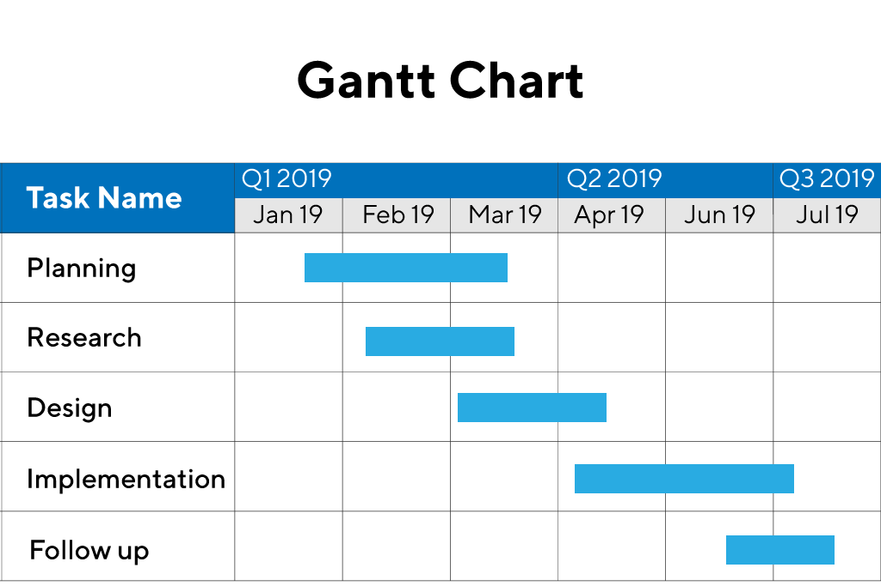
Preparing Your Schedule :
You can only prepare your project schedule after you've estimated the time needed for each task. Create a Gantt Chart to schedule activities and assign resources to your project and to finalize milestones and deadlines.
You can be as detail, the more details the more accurate you'll be. To get a better clue, consider breaking work down into chunks that one person can complete in half a day.
Takes a lot of work, however, this work will pay off later in the project. Just make sure that you leave plenty of time for it in the project's Design Phase.

Slide 13
Specific Outcome: 3
Prepare a cost estimate for an element of work
Cost Estimation Criteria
Should be based on a breakdown of logical parts for estimating
Estimation Questions
How much effort is needed to finish the work?
Project cost estimation and scheduling are often carried out together
Estimates should include implementation and testing of interfaces to other components
Demonstrates an understanding that being assisted by other resources or people could escalate the costs
How much calendar time is needed to complete each activity?
What is the total cost of each activity?
Project Cost Estimation
Effort costs are the primary cost component, including salaries, overheads, and benefits
Other costs include hardware, software, travel, and training

Slide 14
Productivity Estimation
Productivity estimates are necessary for project planning and investment decisions.
Estimation Techniques
Top-down approach: starts at the system level, considering overall functionality and system-level activities.
A commonly used strategy when there is limited information available.
Pricing to Win
Involves agreeing on a project cost and then negotiating the detailed project specification
Bottom-up approach: starts at the component level, estimating effort required for each component.
Each approach has its strengths and weaknesses
Size-related metrics (e.g. lines of code) and function-related metrics (e.g. function points) are used to estimate productivity.
Project Duration and Staffing
Project managers must estimate development time and staffing needs.
The relationship between staff numbers, effort, and development time is non-linear.
Increasing staff numbers can lead to more effort required due to communication and interface definition needs.

Slide 15
Specific outcome: 4
Demonstrate an understanding of the effect of late delivery of an element of work.
Delivery Performance
Late deliveries can impact eligibility and status, but buyer feedback has more weight
Coordination with buyers is crucial to avoid negative feedback and cancellations.
Monitoring Performance
Performance measures provide a management framework and facilitate communication
Indicators for measuring service quality include time, scope, service, and cost
Regular monitoring is essential to identify areas for improvement.
Aspects to Monitor in Logistics
Supply chain response/lead time
Information on status of orders
Efficiency
Total supply chain costs
Inventory value
Order management costs
Cost of waste

Slide 16
Reporting Performance
Customer feedback is essential for evaluating performance. Qualitative and quantitative feedback should be collected. Qualitative, how they felt about the service they were given. In emergency situations, you need to monitor performance quickly, act fast and reporting should be quick and focused so problem can be fixed.
Set clear service standards with customers, like how fast a request should be completed. Compare performance against these standards to see how well the team is doing to see what’s working and what’s not. Use that to improve service
Use the data
There is what we call Key Performance Indicators (KPIs) are specific metrics used to monitor
performance

Slide 17
KPIs examples:
Percentage of items returned/rejected
Total dollar value of damaged/lost goods
Percentage of on-time deliveries
Inventory levels vs. forecasted need
Field distribution performance

Slide 18

114076: Use computer technology to research a computer topic
Image: Duke University

Slide 19
PURPOSE OF THE UNIT STANDARD
To provide a competent knowledge of the areas covered
For those working in, or entering the workplace in the area of End-User Computing
As additional knowledge for those wanting to understand the areas covered.
  Plan the research of a computer topic
  Conduct the research of a computer topic using computer technology, and to
  Present the results of research of a computer topic using computer technology.
The performance of all elements is to a standard that allows for further learning in this area.

Slide 20
LEARNING ASSUMED TO BE IN PLACE AND RECOGNITION OF PRIOR LEARNING
The credit value of this unit is based on a person having prior knowledge and skills to:
Operate a personal computer
Produce presentation documents for business
Demonstrate ability to use the World Wide Web.

Slide 21

Specific Outcome 1
Plan the research of a computer topic
Planning Steps of Research
Identify the problem or topic: Determine the research problem or area of interest, considering feasibility, resources, and potential impact.
Review prior research: Explore existing literature to gain an understanding of the current state of knowledge and inform the research design.
Determine the research purpose, questions, or hypotheses: Clarify the purpose and scope of the study, including research questions or hypotheses.

Slide 22
Introduction to Computer Research
Qualitative research methods are increasingly used in evaluating computer systems and information technology.
The goal of qualitative research is to understand issues or situations by investigating perspectives, behavior, and context.
Qualitative data is gathered through observations, interviews, and documents, and analyzed using systematic techniques.
Understanding user perspectives:
Qualitative methods can help explain user behavior and perceptions of a system.
Understanding social and organizational context:
Qualitative methods can help understand the influence of context on system use and success.
Providing formative evaluation:
Qualitative methods can help improve a program under development schedule.

Slide 23
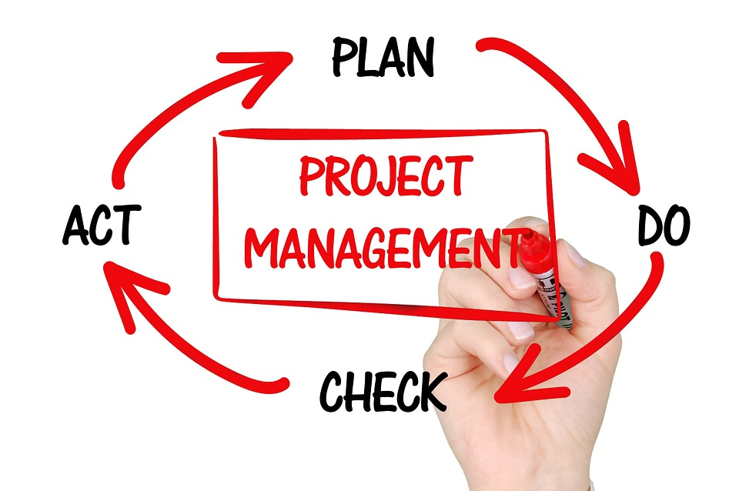
Research Questions and Evaluation Goals
Other Considerations in Planning a Research Project
Some key takeaways from this text include:
Qualitative methods typically focus on description, interpretation, and explanation of events, situations, processes, and outcomes.
Research questions are initially framed as "what," "how," and "why" queries.
Designing: Plan the methodological procedure, including the time schedule and interrelation of steps.
Reporting: Present findings in a written report.
Qualitative research methods are useful for understanding complex issues and contexts.
Research questions should be framed as "what," "how," and "why" queries.
The design stage is critical in planning a research project, including determining the methodological procedure and time schedule.
Qualitative evaluators typically begin with questions such as:
What is happening here?
Why is it happening?
How has it come to happen in this particular way?
What do the people involved think is happening?
How are these people responding to what is happening?
Why are these people responding that way?

Slide 24
SPECIFIC OUTCOME 2 : Conduct research of a computer topic using computer technology.
ASSESEMENT CRITERIA
The research conducted accumulates data according to the research plan. The research conducted provides data analysis with conclusions. The description of the analysis methods allows the validity of the analysis to be assessed. Research progress is indicated at intervals by reports, according to the research plan. The research conducted uses a computer application to analyse the research data.

Slide 25
Data Collection Methods
Some key takeaways from this text include:
Content analysis: systematic examination of oral, written, or visual communication. Experiment: a variety of research designs that use before and after, and/or group comparisons, to measure cause and effect relations. Focus group: a group of similar individuals who provide information during a directed and moderated interactive group discussion. Interview: a directed conversation with an individual using a list of questions designed to gather extended responses. Observation: the systematic observation of behavior using checklists, scaled ratings, or narrative comments. Survey: an ordered series of questions administered to individuals in a systematic manner.
Data collection is a crucial step in the research process, and requires careful planning and implementation. Ethics are essential in data collection, and researchers must present truthful results and avoid misrepresentation or fraud. Qualitative data collection involves gathering information from observations, interviews, and documents, and requires a flexible and adaptive approach. There are various data collection methods to choose from, including content analysis, experiments, focus groups, interviews, observation, and surveys. The choice of data collection method and analysis approach depends on the research question, design, and goals of the study.
When and by Whom Should Data be Collected and Analyzed?
Options include hiring or finding a volunteer outside evaluator, conducting a less formal evaluation, learning enough about statistics and statistical software to conduct a formal evaluation, collecting data and sending it off to someone to process, or collecting and relying largely on qualitative data. Using a randomized or closely matched control group for comparison is recommended, if possible.

Slide 26
Specific Outcome: 3
Present the results of research of a computer topic using computer technology
Data Analysis in Qualitative Research
The goal of qualitative data analysis is to develop an understanding or interpretation that answers the basic question of what is going on.
Data analysis is an ongoing activity that starts as soon as the project begins and continues through the entire course of the research.
The processes of data collection, data analysis, interpretation, and research design are intertwined and depend on each other.
Techniques for Data Analysis
Coding: involves selecting particular segments of data and sorting them into categories that facilitate insight, comparison, and the development of theory.
Analytical Memos: are written notes or reflections that help researchers get ideas down on paper and facilitate reflection and analytical insight
Software for Data Analysis
Computer software can facilitate the process of qualitative analysis by performing mechanical tasks such as storing and coding data, retrieving and aggregating previously coded data, and making connections among coding categories.
There are different types of programs, some developed specifically for data analysis, and others (including word processors, textbase managers, and network builders) that can be used for some of the tasks of analysis.

Slide 27
Validity in Qualitative Research
Validity addresses the necessarily "subjective" nature of data collection and analysis.
Qualitative researchers acknowledge their role as research instruments by making it an explicit part of data collection, analysis, and reporting.
Researchers use various strategies to control the effects of their background and role, such as including specific ways to understand and control biases and perceptions.
Strategies for Ensuring Validity
Rich Data: collecting detailed and varied data that provides a full and revealing picture of what is going on.
Feedback or Member Checking: systematically gathering feedback about one's conclusions from participants in the setting studied and from others familiar with the setting.
Searching for Discrepant Evidence and Negative Cases: identifying and analyzing data that do not fit prior theories or conclusions.
Reporting Observation Results
Analyze the data by reviewing the completed observation form and any written comments.
Determine findings based on the analysis and in relation to the research questions and previous research findings.
Report results in a way that is clear and useful to the audience, including discussing practical or theoretical implications, major shortcomings or limitations, and directions for future research.

Slide 28

Some key takeaways from this text include:
Qualitative data analysis is an ongoing and iterative process that involves coding, memoing, displaying, and contextual and narrative analysis.
Computer software can facilitate the process of qualitative analysis, but the researcher must still perform the conceptual and analytical work of making sense of the data.
Validity in qualitative research is ensured through strategies such as collecting rich data, gathering feedback from participants, and searching for discrepant evidence and negative cases.
Reporting observation results involves analyzing the data, determining findings, and presenting the results in a clear and useful way.

Slide 29
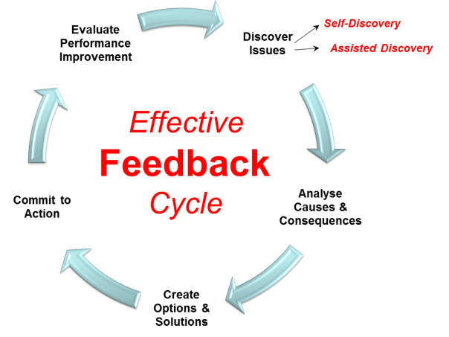
115431: Analyze feedback contexts and apply constructive feedback techniques

Slide 30
PURPOSE OF THE UNIT STANDARD
To provide fundamental knowledge of the areas covered
For those working in, or entering the workplace in the area of Business and Organisation Communication
As additional knowledge for those wanting to understand the areas covered
Analyze feedback contexts and / or situations
Give constructive feedback
Respond constructively to feedback
The performance of all elements is to a standard that allows for further learning in this area.
LEARNING ASSUMED TO BE IN PLACE AND RECOGNITION OF PRIOR LEARNING
The credit value of this unit is based on a person having prior knowledge and skills to:
Communicate and write in English, at least at NQF level 3.

Slide 31
LEARNING ASSUMED TO BE IN PLACE AND RECOGNITION OF PRIOR LEARNING
The credit value of this unit is based on a person having prior knowledge and skills to:
Communicate and write in English, at least at NQF level 3.

Slide 32
SPECIFIC OUTCOME: 1
PROVIDE CONSTRUCTIVE FEEDBACK :
Purpose of Feedback: Feedback is essential for guiding employees, improving performance, and enhancing productivity. It helps individuals understand their strengths and weaknesses, and make
Situations Requiring Feedback: Feedback is necessary in various situations, including ongoing performance discussions, providing specific performance pointers, following up on coaching discussions, giving corrective guidance, and letting someone know the consequences of their behavior.
Clues that Feedback is Needed: Feedback is needed when someone asks for your opinion, unresolved problems persist, errors occur repeatedly, an employee's performance doesn't meet expectations, or a peer's work habits are disturbing.

Slide 33

The Six Step Method for Giving Constructive Feedback:
State the purpose of your feedback.
Describe specifically what you've observed.
Describe your reactions and the consequences.
Give the person an opportunity to respond.
Offer specific suggestions for improvement.
Summarize and express your support.
SIX WAYS TO MAKE FEEDBACK CONSTRUCTIVE :
Only give feedback with a constructive purpose.
Describe behavior instead of judging it.
Focus on observable actions rather than assumptions.
Criticize behavior, not the person.
Balance positive and negative feedback.
Avoid feedback overload by focusing on key points.

Slide 34
Key Takeaways
Feedback is a crucial tool for improving performance and productivity
Constructive feedback should focus on description, observation, and behavior rather than judgment, inference, or personal traits
The six-step method provides a structured approach to giving constructive feedback
Feedback should be specific, timely, and balanced, with a focus on improvement and growth

Slide 35
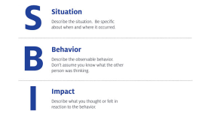
SPECIFIC OUTCOME: 2
Analyze feedback contexts and/ or situations
The Situation – Behavior – Impact (SBI) : Feedback Tool is a structured approach to giving effective feedback. Developed by The Center for Creative Leadership, it helps you deliver clear, specific feedback that your team members can understand and act upon.
Key Components of the SBI Feedback Tool:
Set the context by defining where and when the situation occurred. This helps the recipient understand the specific scenario you're referring to.
Describe the specific behaviors you observed, focusing on objective, measurable information. Avoid assumptions or subjective judgments.
Explain how the behavior affected you or others, using "I" statements to express your feelings and thoughts.
Situation:
Behavior:
Impact:

Slide 36
Guidelines for Giving Constructive Feedback
When giving feedback, it's essential to present it in a way that the receiver doesn't feel threatened or attacked.
Focus on behavior, not the person: Direct feedback toward behavior that can be changed, rather than attacking the person's personality or traits.
Consider the receiver's needs: Prioritize the value and usefulness of the feedback to the receiver, rather than your own need to express it.
Use "I" statements: Express your perceptions, experiences, or feelings about the behavior using "I" statements.
Focus on actions, not motives: Concentrate on what was said and done, rather than why it was said or done.

Slide 37
SPECIFIC OUTCOME 3:
Respond constructively to feedback
Giving constructive feedback is crucial for managers and supervisors to guide employees toward meeting expectations and goals. It's used to support effective behavior or redirect problem performance. Situations that require constructive feedback include ongoing performance discussions, coaching, and corrective guidance. Clues that feedback is needed include requests for opinion, persistent problems, repeated errors, unmet expectations, and disturbing work habits. The goal is to provide guidance and support to achieve successful performance.

